Slide 1
Your Educational Tour {Year}
{School Name Here}, Years {7 & 8}

Slide 2
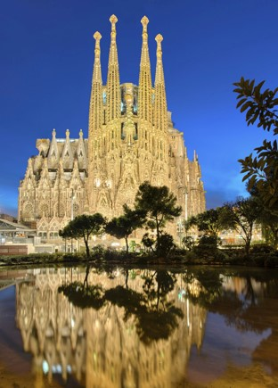
Educational Trip {Year}
{school name}
Why book with Equity?
INSPIRING LEARNING EXPERIENCES FOR YOUNG PEOPLE
For us, a tour is more than just travelling to a new place, it’s the inspiring learning experiences you have when you get there. We use over 80 years of experience to deliver a tour that not only meets your needs but adds something that little bit different to make it an experience to be remembered.

Slide 3
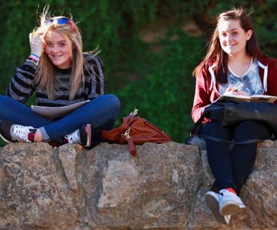
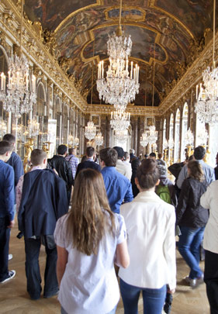
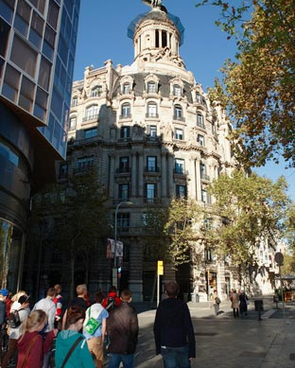
Educational Trip {Year}
{school name}
Your Header
YOUR SUBTITLE
Here is some dummy content for your main paragraph of a standard page. Use this layout to provide info on the resort and any other relevant information. Use this layout to provide info on the resort and any other relevant information.

Slide 4
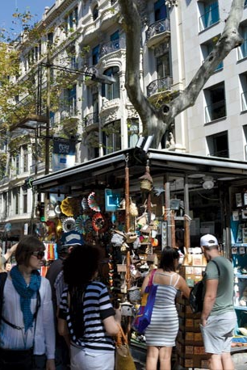
Where will we visit?
Add excursions here
Add excursions here
Add excursions here
Add excursions here
Add excursions here
Add excursions here
Add excursions here
Add excursions here

Slide 5
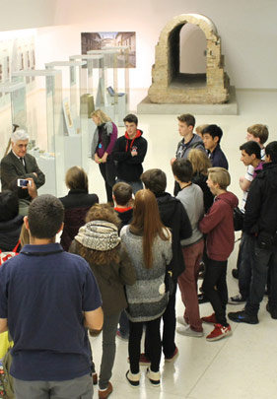
Educational Trip {Year}
What are our Art & Design objectives?
Raise the profile of the Art Department within your school
Promote understanding of how art relates to place, context and culture
Fulfil GCSE and new AS and A2 exam specifications
Focus on particular artists, movements or themes
Enhance cross-curricular understanding
Have fun discovering the creative world with your students!

Slide 6

Educational Trip {Year}
What are our Business Studies objectives?
Raise the profile of your school's Business Department
Fulfil GCSE AS and A2 exam specifications
Extend understanding of the world of business and finance
Compare the complexity of real visits with familiar textbook examples
Understand locational factors of industrial sites
Have fun on a diverse range of business visits with your students!

Slide 7
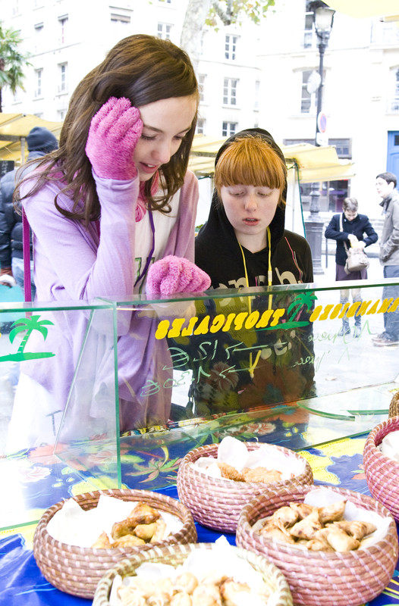
Educational Trip {Year}
What are our Languages objectives?
Practise listening and speaking skills in everyday scenarios
Learn to communicate with increasing confidence
Build on existing linguistic understanding and develop a wider range of vocabulary
Apply linguistic knowledge and skills in new and challenging settings
Gain first-hand experience of Local culture and society

Slide 8
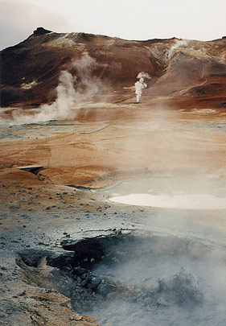
Educational Trip {Year}
What are our Geography objectives?
Raise the profile of your school's Geography Department
Fulfil GCSE, AS and A2 exam specifications
Promote understanding of cultural diversity and global challenges
Compare unfamiliar geographies with your local case studies
Enhance cross-curricular understanding
Have fun discovering the world with your students!

Slide 9
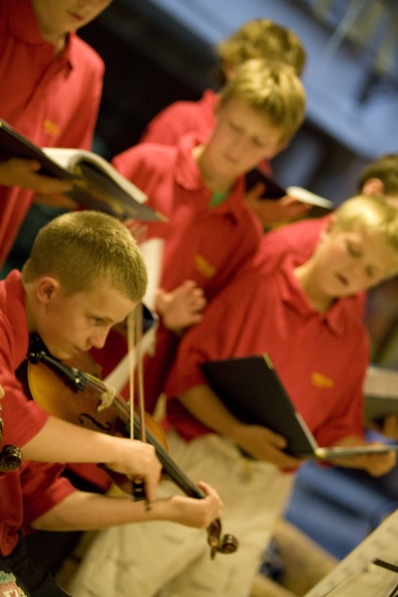
Educational Trip {Year}
What are our Music objectives?
Increase self-confidence and develop performance skills
Broaden range of performance experiences
Build appreciation of different musical styles and traditions
Inspire and excite your students with new sights and cultures
Focus your pupils to extend their interest in music
Build team work and have fun interacting with fellow students

Slide 10
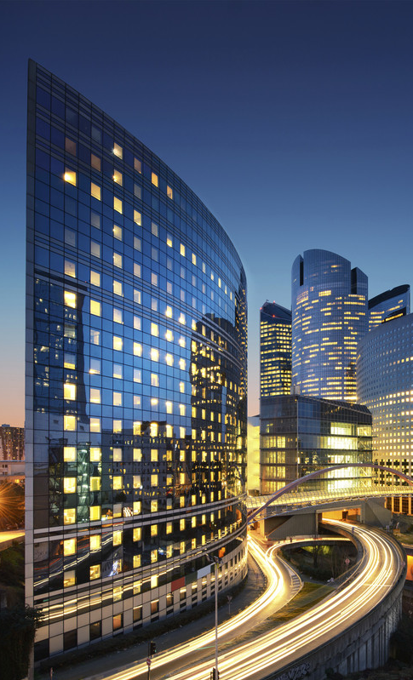
Educational Trip {Year}
What are our ICT objectives?
Raise the profile of your school's ICT department
Extend classroom learning and curriculum links
Get inspired by real design solutions
Compare real products with familiar textbook examples
Gain insight into factors which constrain design processes
Have fun investigating customer needs and opportunities

Slide 11

Educational Trip {Year}
What are our Politics objectives?
Visit the places where major political decisions have been made
Watch politics in action in a parliamentary debate
Watch the Criminal Court proceedings
Meet and talk about political issues with individual MEPs
Talk to lobbyists and investigate politics first hand

Slide 12
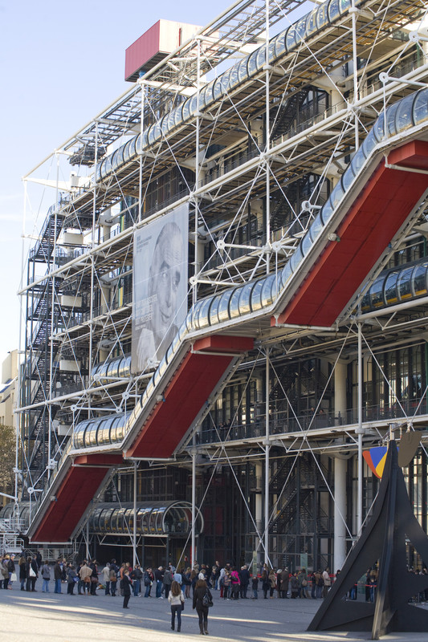
Educational Trip {Year}
What are our Science objectives?
Use practical experience as a basis for scientific discovery
Trace the developments of science worldwide
Appreciate the relevance of historic discoveries in modern science
Reinforce learning through experimentation, observation and analysis
Explore creative and commercial applications of science
Recognise the importance of ethics and sustainability
Discover new and exciting career opportunities within science

Slide 13
Educational Trip {Year}
What are our Religious Studies objectives?
Gain a better understanding of world religions and beliefs
Explore the influence of religion and beliefs on how people live their lives.
Understand the historical context of beliefs and practices and how they change over time.
Explore the diversity of forms in which beliefs are expressed
Analyse the differences and relationships that exist between religions, values and beliefs.
Evaluate how different religions have responded questions that confront humanity
Understand how moral values and a sense of obligation can come from beliefs and experience

Slide 14
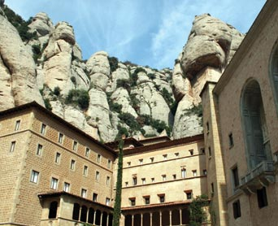
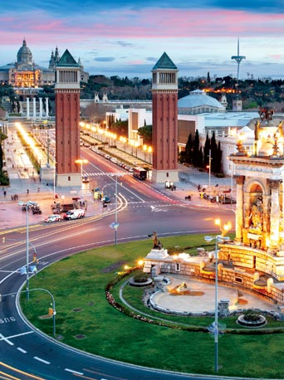
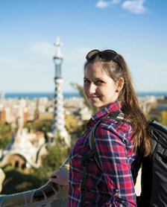
Educational Trip {Year}
Insert additional information here

Slide 15
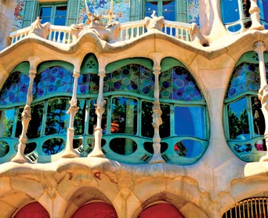
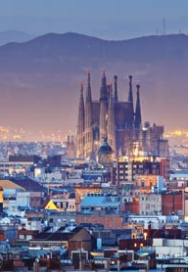
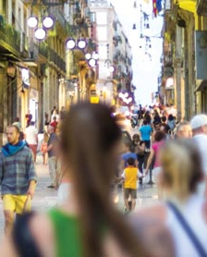
Barcelona Trip {Year}
Insert additional information here

