Slide 1
Your Berlin Tour {Year}
{School Name Here}, Years {7 & 8}

Slide 2
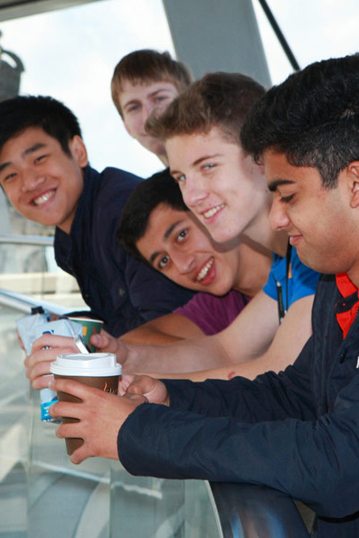
Berlin Trip {Year}
{school name}
Why book with Equity?
INSPIRING LEARNING EXPERIENCES FOR YOUNG PEOPLE
For us, a tour is more than just travelling to a new place, it’s the inspiring learning experiences you have when you get there. We use over 80 years of experience to deliver a tour that not only meets your needs but adds something that little bit different to make it an experience to be remembered.

Slide 3
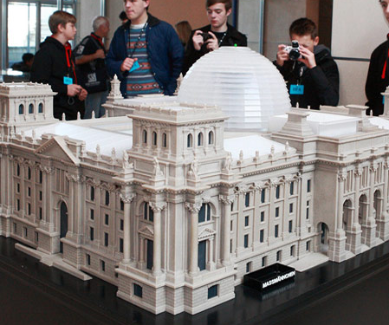
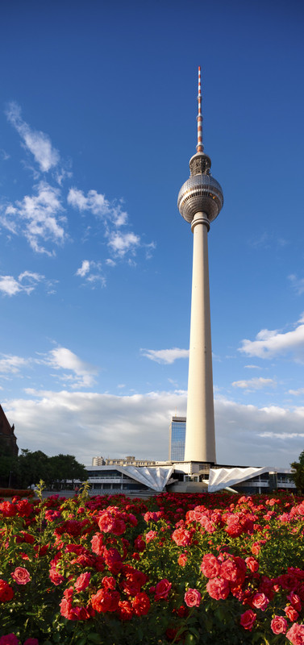
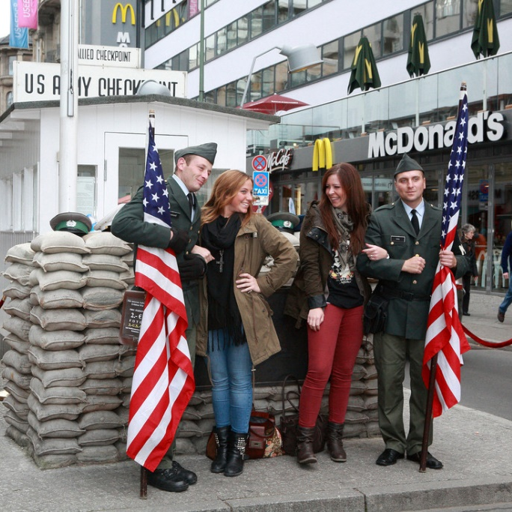
Berlin Trip {Year}
{school name}
Your Header
YOUR SUBTITLE
Here is some dummy content for your main paragraph of a standard page. Use this layout to provide info on the resort and any other relevant information. Use this layout to provide info on the resort and any other relevant information.

Slide 4
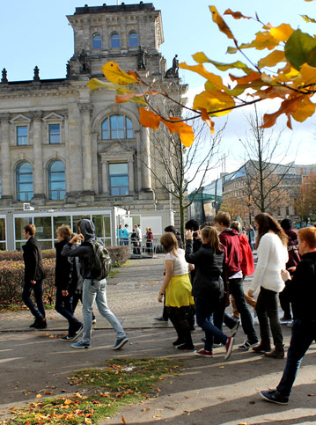
Where will we visit?
The Story of Berlin
Eastside Gallery
Jewish Museum
Sachsenhausen Memorial
Topography of Terror
Checkpoint Charlie Museum
Die Brucke Museum
Bauhaus Museum
Berlinische Galerie
Neue National Gallerie
Kathe Kolwitz Museum
Wannsee Conference Centre
Kurfurstendamm
Tropical Island
Filmpark Babelsberg

Slide 5
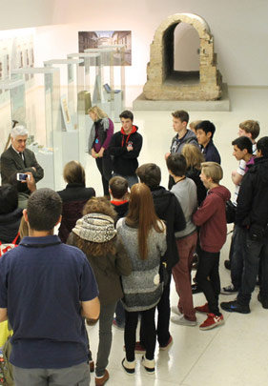
Berlin Trip {Year}
What are our History objectives?
Walk in the rooms of the Wannsee mansion where the Holocaust was planned
Investigate the scale of the Nazi terror state at the Topography of Terror
Walk alongside a section of the preserved Wall
Trace the steps of 100,000 victims of the Holocaust at Sachenshausen
Investigate attempts to cross the Wall at Checkpoint Charlie
Reflect on victims of the Holocaust at the Jewish museum

Slide 6
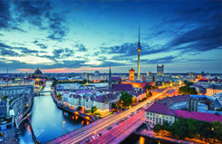
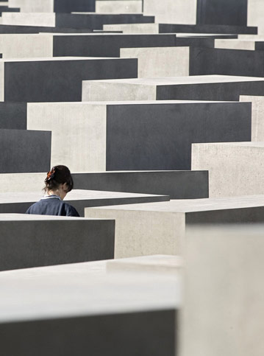
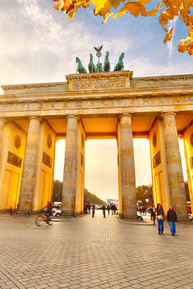
Berlin Trip {Year}
Insert additional information here

Slide 7
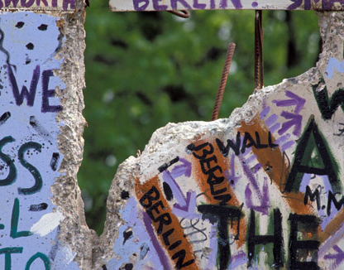
Berlin Trip {Year}
Insert additional information here

