Slide 1
Your trip to Normandy
{School Name Here}, Years {7 & 8}

Slide 2
Normandy Trip {Year}
{school name}
Why book with Equity?
INSPIRING LEARNING EXPERIENCES FOR YOUNG PEOPLE
For us, a tour is more than just travelling to a new place, it’s the inspiring learning experiences you have when you get there. We use over 80 years of experience to deliver a tour that not only meets your needs but adds something that little bit different to make it an experience to be remembered.

Slide 3
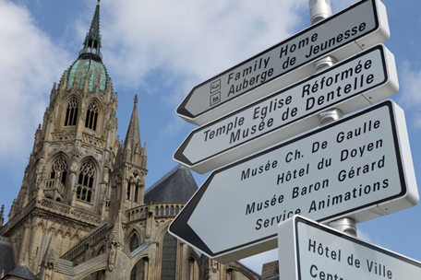
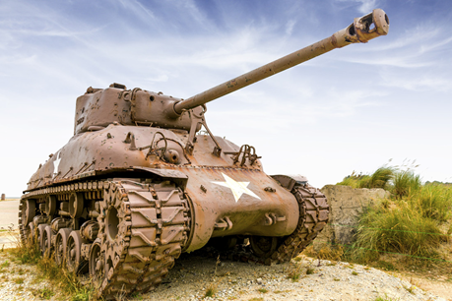
Normandy Trip {Year}
{school name}
Your Header
YOUR SUBTITLE
Here is some dummy content for your main paragraph of a standard page. Use this layout to provide info on the resort and any other relevant information. Use this layout to provide info on the resort and any other relevant information.

Slide 4
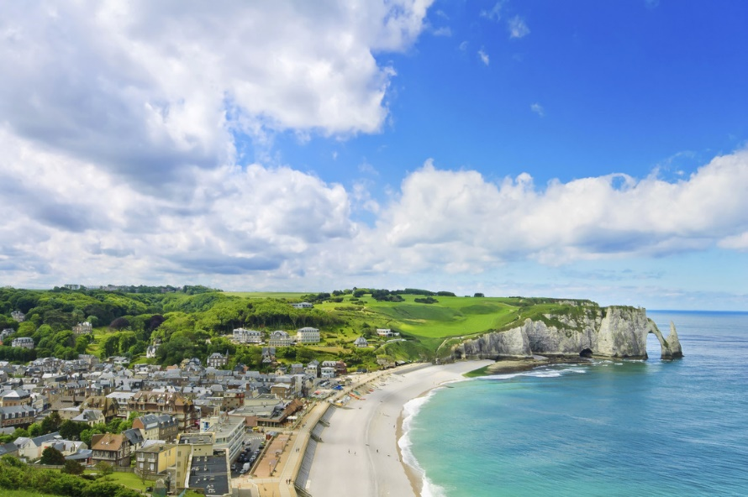
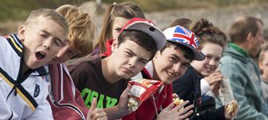
Where will we visit?
Arromanches 360 Cinema and Landings Museum
American Cemetery, Omaha
Caen Memorial Museum
Pegasus Bridge Museum
Juno Beach Centre
Bayeux Tapestry
Bayeux Market
Boulangerie les Co-Pains - Bakery
Mont Saint Michel
EANA sustainable centre
Paleospace
Port of Honfleur
Caen Fine Arts Museum
Rouen Cathedral and medieval centre
Giverny Monet's Garden
Christian Dior Museum
La Grange au Mohair - Goat Farm

Slide 5
What are our History objectives?
Normandy Trip {Year}
Investigate real events in their original context
Appreciate the daunting task faced by the Allied Forces
Pay your respects at Normandy’s war cemeteries
Enable students to see and handle real artefacts
Witness the scale of events at the Normandy Landing Beaches
Integrate history on the ground with student’s classroom learning

Slide 6
What are our Language objectives?
Normandy Trip {Year}
Enhance cross-curricular understanding
Practise listening and speaking in everyday situations
Gain first-hand experience of French culture and society
Build on existing linguistic understanding
Develop a wider range of vocabulary
Apply linguistic knowledge in new challenging setting
Learn to communicate with increasing confidence
Read signs, shop in the market and have fun in French

Slide 7
What are our Art & Design objectives?
Normandy Trip {Year}
Visit the birthplace of Impressionism
Explore sources for artists ‘research’
Examine the context in which artists work
Compare artists’ lives and experiences
Experience paintings first hand and evaluate the work
See the Bayeux Tapestry for yourselves

Slide 8
What are our Maths objectives?
Normandy Trip {Year}
Explore links between maths and history
Record data to present in the classroom
Identify architectural shapes and geometry
Investigate costings for an national engineering project
Discover the origins of latitude and longitude
Use French to have fun in Maths!

Slide 9
Normandy Trip{Year}
Insert additional information here

