Slide 1
Your Rome Tour {Year}
{School Name Here}, Years {7 & 8}

Slide 2
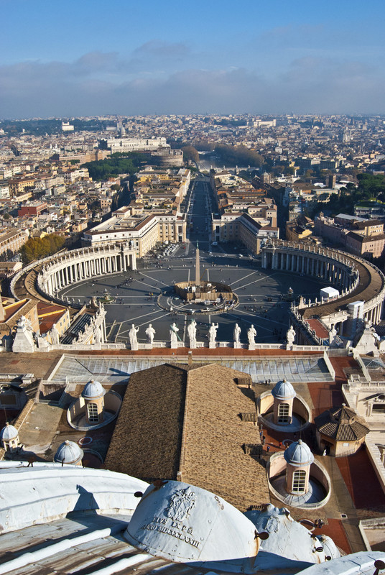
Rome Trip {Year}
{school name}
Why book with Equity?
INSPIRING LEARNING EXPERIENCES FOR YOUNG PEOPLE
For us, a tour is more than just travelling to a new place, it’s the inspiring learning experiences you have when you get there. We use over 80 years of experience to deliver a tour that not only meets your needs but adds something that little bit different to make it an experience to be remembered.

Slide 3
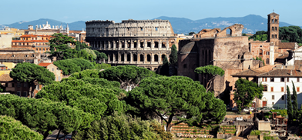
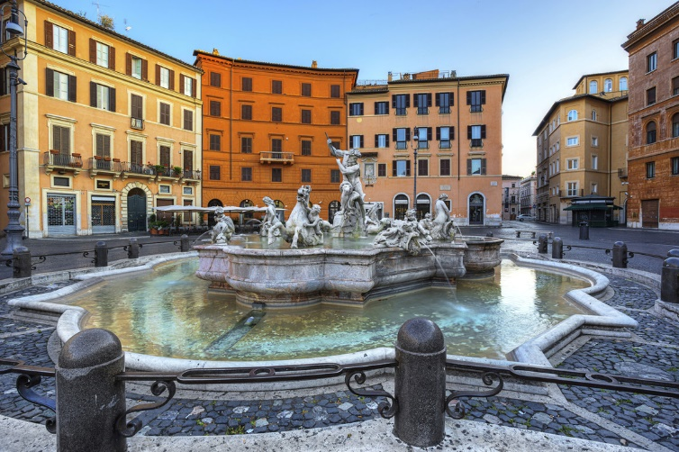
Why book with Equity?
{school name}
Your Header
YOUR SUBTITLE
Here is some dummy content for your main paragraph of a standard page. Use this layout to provide info on the resort and any other relevant information. Use this layout to provide info on the resort and any other relevant information.

Slide 4
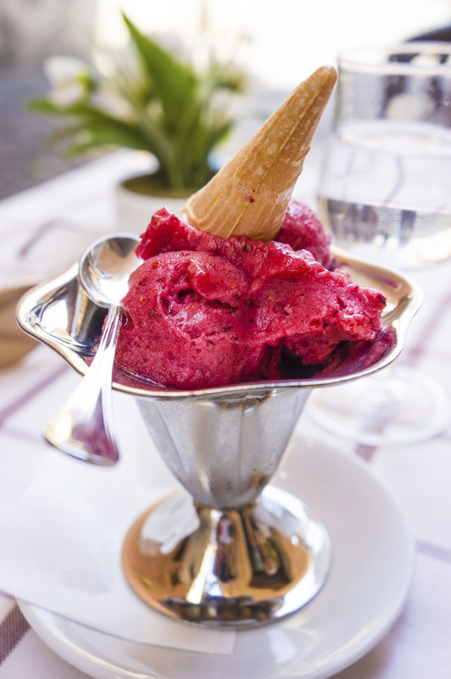
Where will we visit?
Vatican
Colosseum
Forum
St Peters Basilica
Catacombs
Time Travel Elevator - 3D cinema and ride
Pantheon
Borghese Gallery
Galleria Nazionale d'Arte Moderna
Trevi Fountain
Trajan Column
Museum of Roman Civilisation
Hadrian's Villa
Circus Maximus – Roman chariot racing stadium
Ostia
Pasta Museum

Slide 5
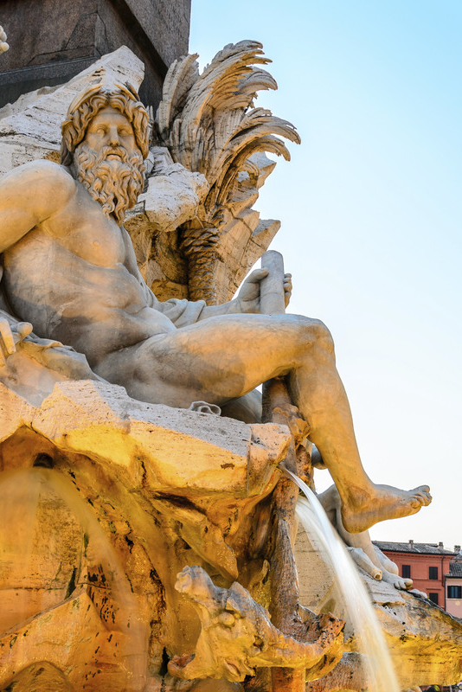
What are our Classics objectives?
Rome Trip {Year}
Examine social, religious, military and democratic contexts
Understand language, culture and literature of the Empire
Assess reasons for changes in architectural and sculptural style
Critically assess design and extent of Roman Town Planning
Identify important characteristics of Roman architecture
Evaluate how factors such as water supply and sanitation were managed

Slide 6
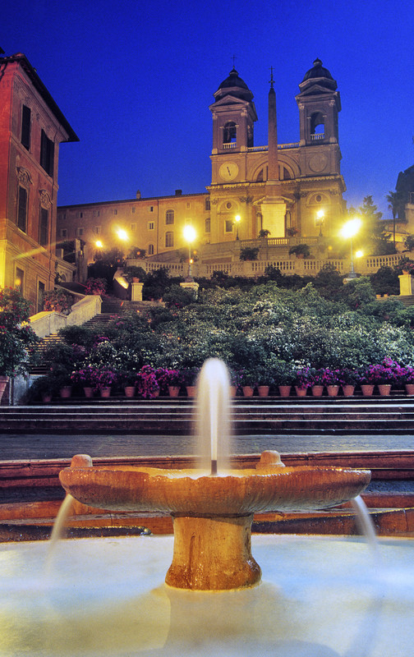
What are our Art & Design objectives?
Rome Trip {Year}
Investigate how the Christian church supported development of art and sculpture
Discover Michaelangelo's endeavours to decorate the ceiling of the Sistine Chapel
Photograph the Forum and Colosseum to analyse principles of Roman architecture
Examine Bernini's contribution to public art and development of Baroque sculpture
Identify how Roman ideas of town planning have influenced modern design

Slide 7
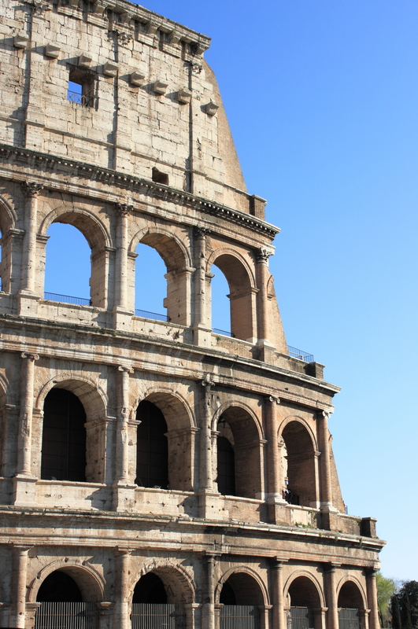
What are our History objectives?
Rome Trip {Year}
Witness the spectacle and cruelty represented by the Colosseum
Step back in time in the multi-sensory Time Elevator
Stroll where Rome’s rulers walked in the Imperial Forum
Identify the stories on Trajan's Column
Stand under the huge 1900 year-old dome of the Pantheon
Glimpse the burial places of Rome’s early Christians

Slide 8
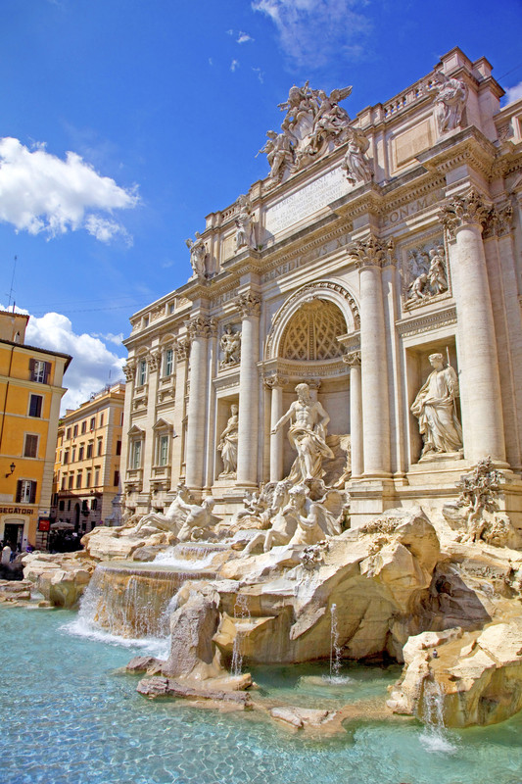
What are our Language objectives?
Rome Trip {Year}
Practise listening and speaking skills in everyday scenarios
Experience reading and writing comprehension in daily life
Build on existing linguistic understanding
Develop a wider range of vocabulary
Apply linguistic knowledge and skills in new and challenging settings
Gain first-hand experience of Italian culture and society
Learn to communicate with increasing confidence

Slide 9
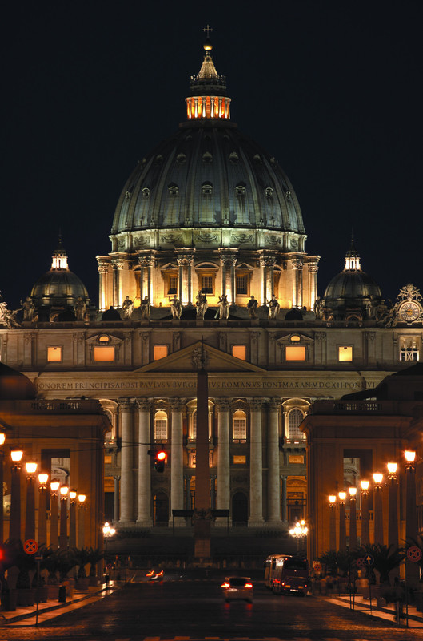
What are our Religious Studies objectives?
Rome Trip {Year}
Gain better understanding of one of the worlds important religions
Explore the foundation, development and spread of Catholicism
Compare the beliefs of the Catholic Church to other religions
Understand the manner of worship and ritual
Understand historical development of the Christian Church
Examine the role of art as a form of religious expression

Slide 10
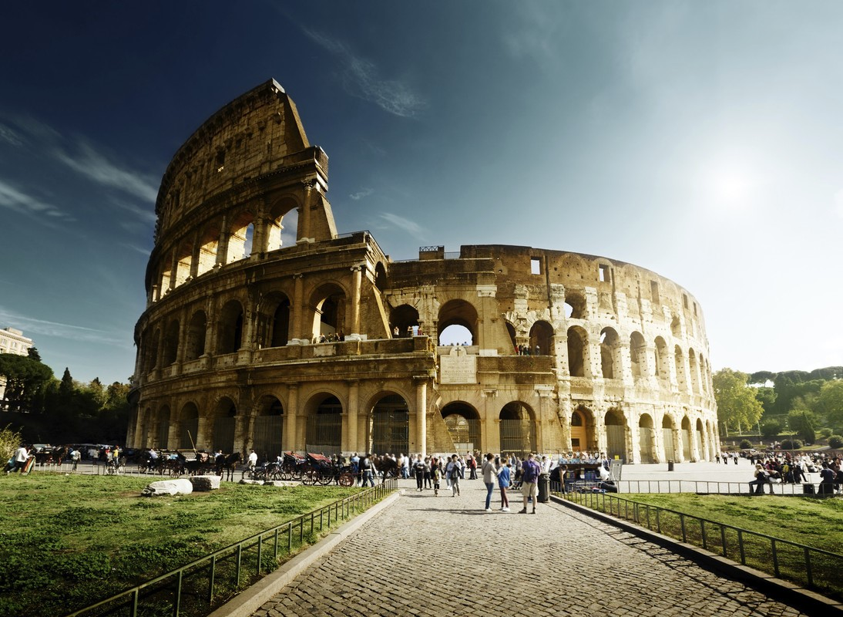
Rome Trip {Year}
Insert additional information here

