Slide 1
Your New York Tour {Year}
{School Name Here}, Years {7 & 8}

Slide 2

New York Trip {Year}
{school name}
Why book with Equity?
INSPIRING LEARNING EXPERIENCES FOR YOUNG PEOPLE
For us, a tour is more than just travelling to a new place, it’s the inspiring learning experiences you have when you get there. We use over 85 years of experience to deliver a tour that not only meets your needs but adds something that little bit different to make it an experience to be remembered.

Slide 3
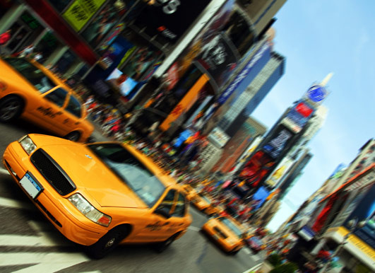
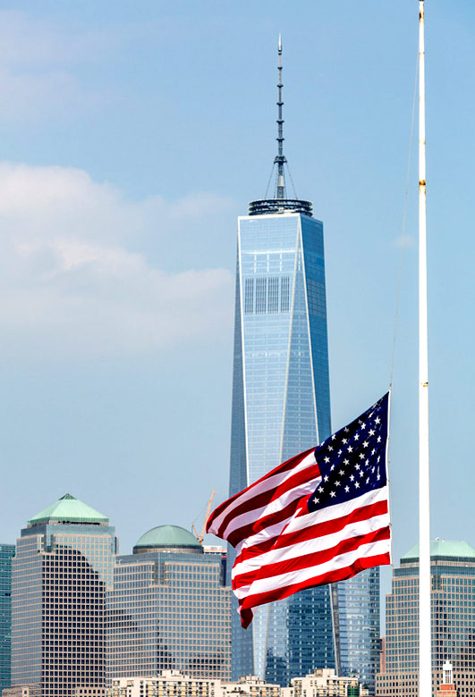
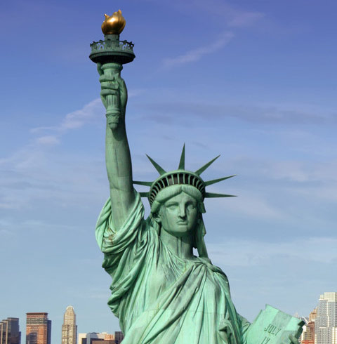
New York Trip {Year}
{school name}
Your Header
YOUR SUBTITLE
Here is some dummy content for your main paragraph of a standard page. Use this layout to provide info on the resort and any other relevant information. Use this layout to provide info on the resort and any other relevant information.

Slide 4
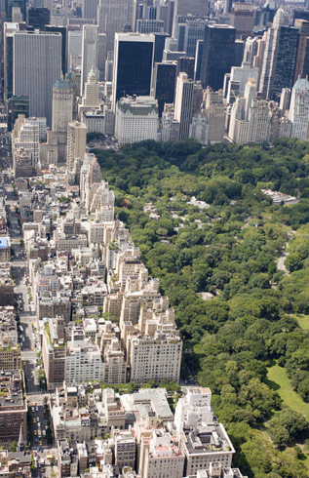
Where will we visit?
Statue of Liberty Cruise
Empire State Building
Top of the Rock Observation Deck
Guggenheim Museum
Metropolitan Museum of Art
Walking Tour
Circle Line Cruise
American Museum of Natural History
WTC Memorial Visitor Centre
Brooklyn Naval Yard Tour
Tenement Museum
Ellis Island Immigration Museum
Holocaust Museum
UN Tour
Sony or Samsung Centre
NBC studio tour

Slide 5
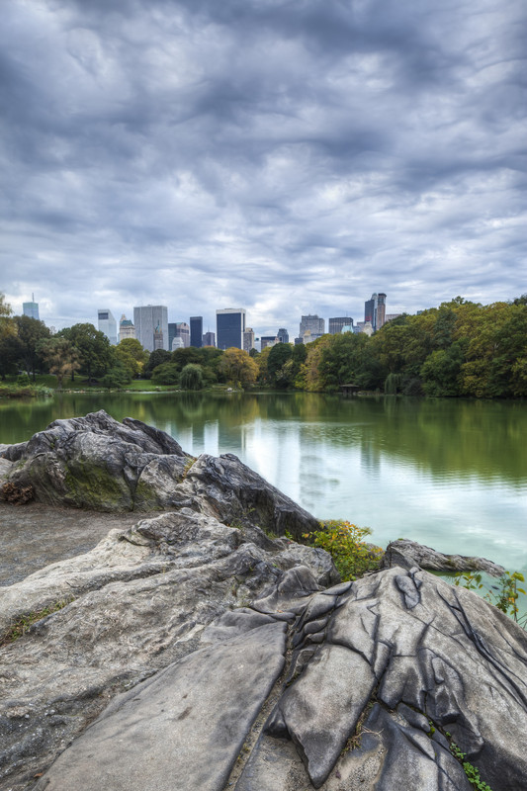
New York Trip {Year}
What are our English objectives?
Explore how texts relate to the historic contexts in which they were written
Engage with literature and theatre beyond the classroom
Appreciate the global heritage of the English language
Evaluate and respond constructively to performances
Gain inspiration and motivation for creative writing
Discover a renewed passion for English literature

Slide 6
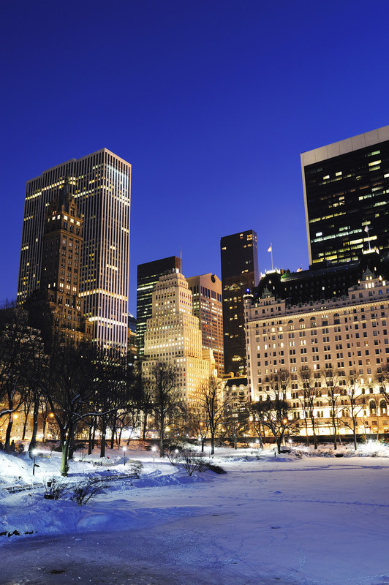
New York Trip {Year}
What are our Business Studies objectives?
Identify key locational factors for New York’s development
Trace New York’s trading and industrial history
Identify reasons for the success of the world’s largest retail store
Investigate the world of money at the Federal Bank
Examine current challenges of monetary recession
Assess marketing techniques at Macy’s

Slide 7
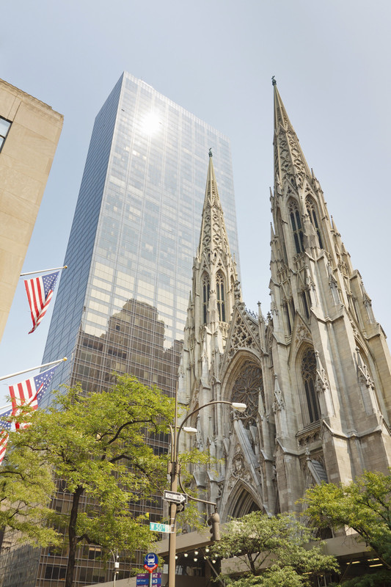
New York Trip {Year}
What are our Geography objectives?
Examine urban regeneration issues
Investigate transport challenges and solutions
Record evidence of immigration and multiculturalism
Assess social and economic inequalities
Identify the characteristics of a world city
Collect data on retail patterns

Slide 8

New York Trip {Year}
What are our Art & Design objectives?
Research development of artistic movements as reactions to the past
Identify buildings designed by famous and innovative architects
Assess the relationship between architectural design and urban context
Appreciate art as a means of expression across time and cultures
Study photographic techniques and processes
Capture changing urban vistas on camera

Slide 9

New York Trip {Year}
What are our Business studies objectives?
Identify key locational factors for New York’s development
Trace New York’s trading and industrial history
Identify reasons for the success of the world’s largest retail store
Investigate the world of money at the Federal Bank
Examine current challenges of monetary recession
Assess marketing techniques at Macy’s

Slide 10
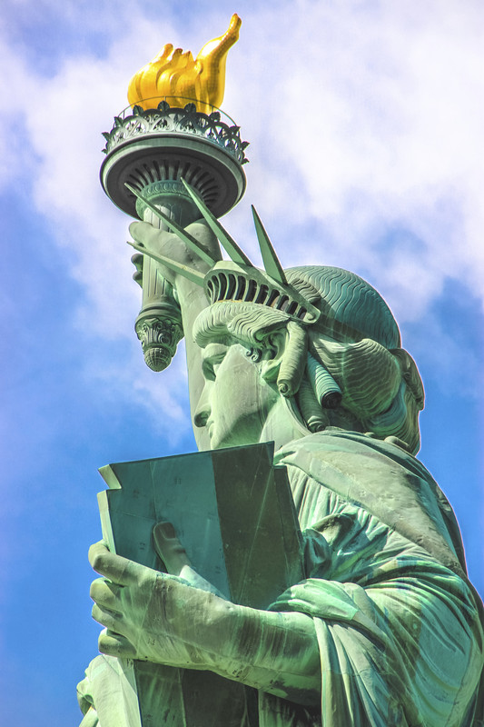
New York Trip {Year}
What are our Maths objectives?
Gain insight into the workings of the Federal Bank
Explore the links between maths, art and architecture
Record data to present in the classroom
Use simple trigonometry to calculate height of structures
Calculate speed and distance on the Subway
Have fun investigating the latest maths museum

Slide 11
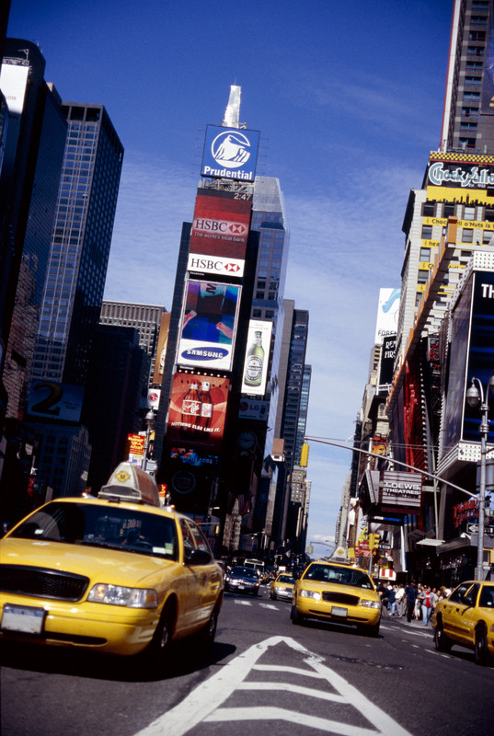
New York Trip {Year}
What are our Politics objectives?
Re-live the experience of new immigrants on Ellis Island
Experience the hardship of immigrant life in a tenement
Ascend the Statue of Liberty, beacon of freedom
Reflect on recent history at the Tribute WTC Visitor Center
Appreciate the technological impact of the Empire State building

Slide 12
New York Trip {Year}
Insert additional information here

Slide 13
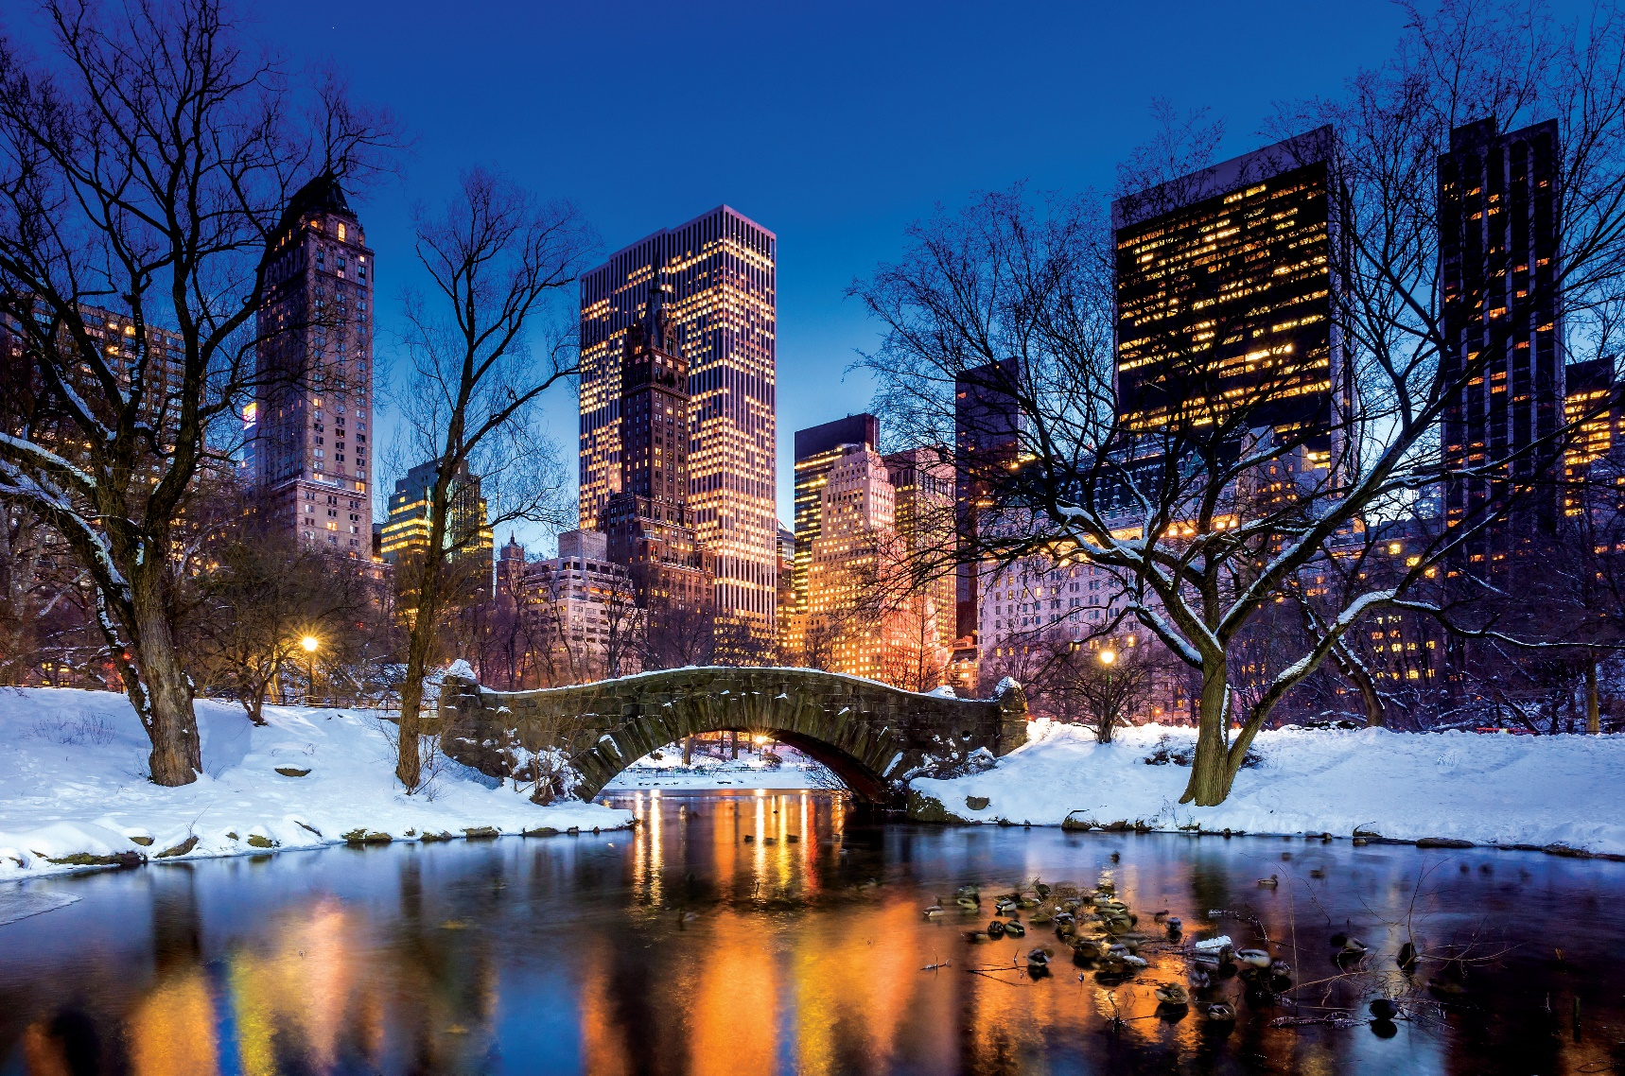
New York Trip {Year}
Insert additional information here

