Slide 1
Your Opal Coast Tour {Year}
{School Name Here}, Years {7 & 8}

Slide 2
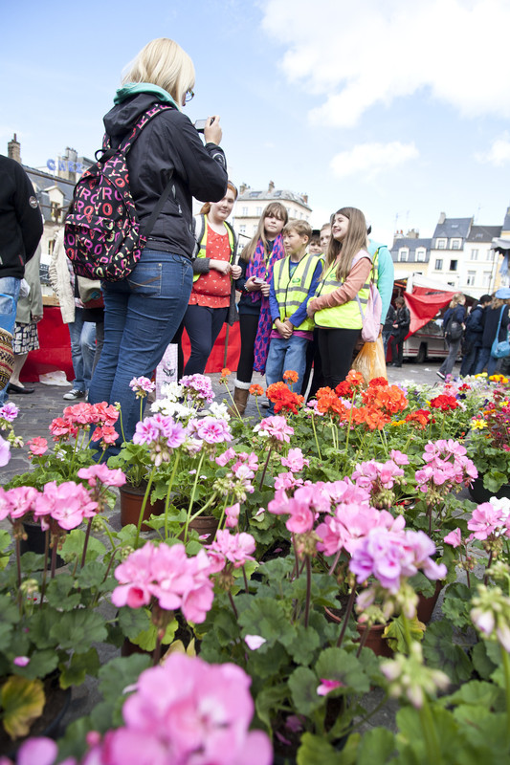
Opal Coast Trip {Year}
{school name}
Why book with Equity?
INSPIRING LEARNING EXPERIENCES FOR YOUNG PEOPLE
For us, a tour is more than just travelling to a new place, it’s the inspiring learning experiences you have when you get there. We use over 80 years of experience to deliver a tour that not only meets your needs but adds something that little bit different to make it an experience to be remembered.

Slide 3
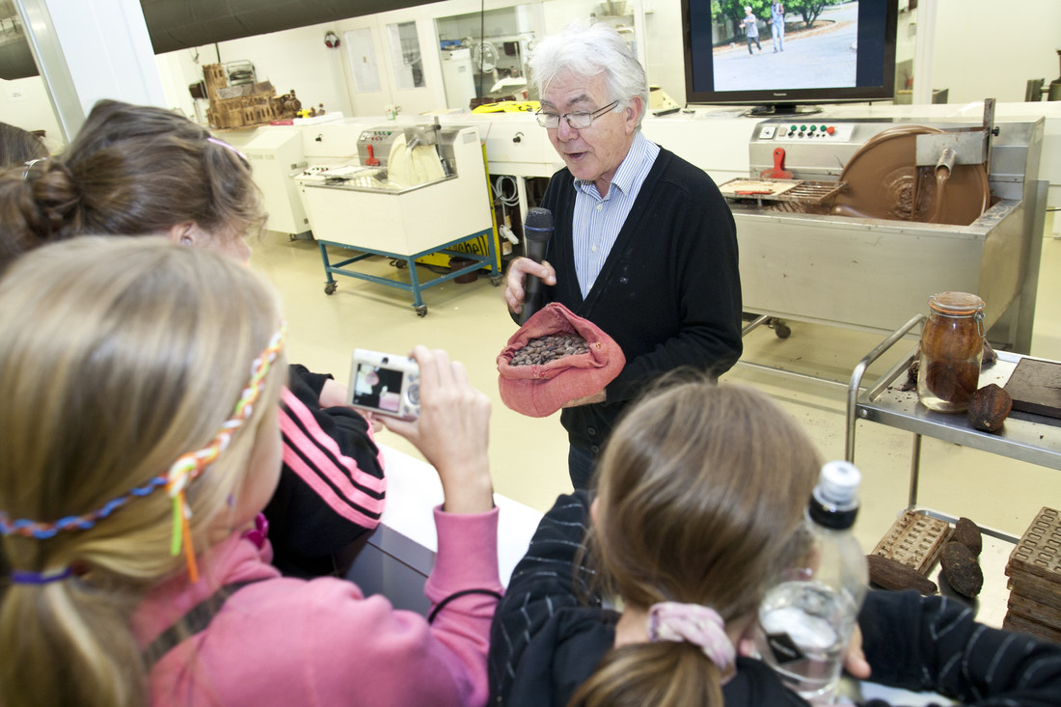
Why book with Equity?
{school name}
Your Header
YOUR SUBTITLE
Here is some dummy content for your main paragraph of a standard page. Use this layout to provide info on the resort and any other relevant information. Use this layout to provide info on the resort and any other relevant information.

Slide 4
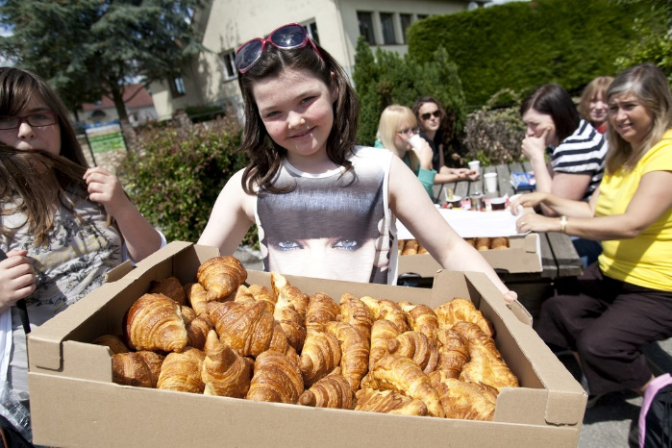
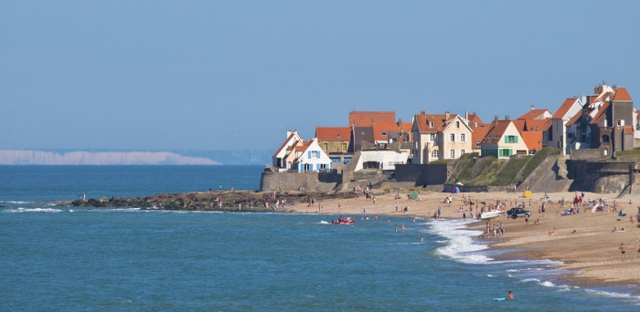
Where will we visit?
Opal Coast Trip {Year}
WWI cemeteries
La Coupole Museum
Agincourt medievel centre
Vimy Ridge, Canadian Memorial
Pèronne 'Historical' Museum
Nausicaa Sea Life Centre
Chocolaterie
Cheese Farm
Le Succès Berckois - Sweet Shop
La Boulangerie Maillard - Bakery
Les Escargots du Bocage - Snail Farm
Parc Bagatelle amusement park
Amiens floating flower market

Slide 5
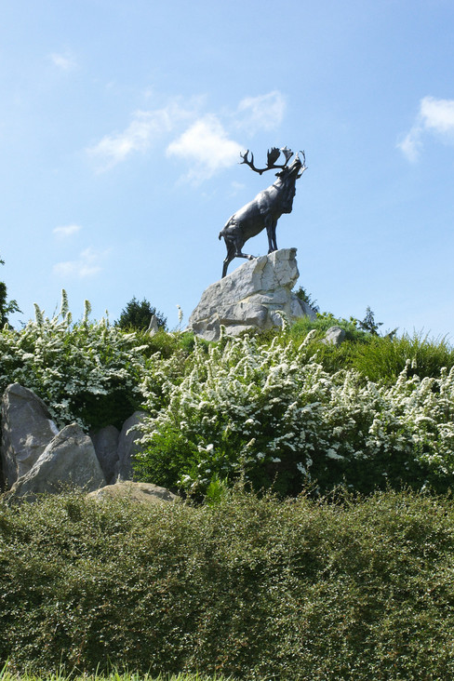
What are our History objectives?
Opal Coast Trip {Year}
Witness the sheer scale and horror of trench warfare
Walk in the steps of the troops
Imagine conditions for those who fought in WWI
Investigate how La Coupole resisted repeated Allied bombing efforts
Explore 17th century ramparts built by one of the greatest military engineers

Slide 6
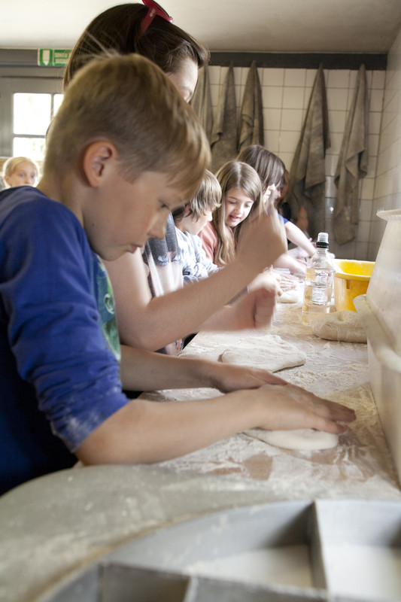
What are our Language objectives?
Opal Coast Trip {Year}
Practise listening and speaking skills in everyday scenarios
Experience reading and writing comprehension in daily life
Build on existing linguistic understanding
Develop a wider range of vocabulary
Apply linguistic knowledge and skills in new and challenging settings
Gain first-hand experience of French culture and society
Learn to communicate with increasing confidence

Slide 7
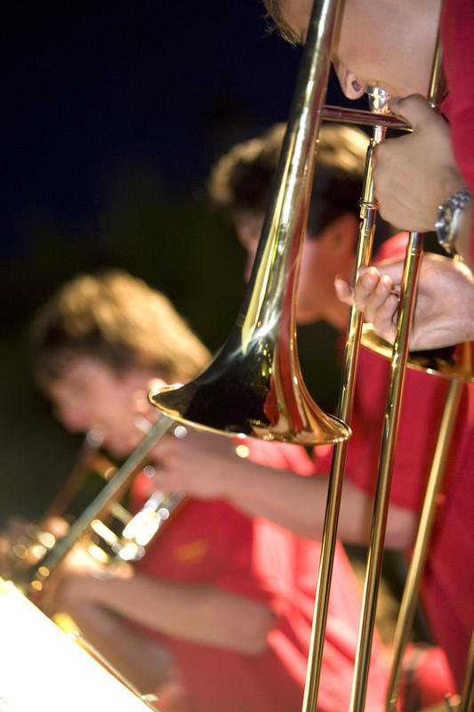
What are our Music objectives?
Opal Coast Trip {Year}
Increase self-confidence and develop performance skills
Broaden range of performance experiences
Build appreciation of different musical styles and traditions
Inspire and excite your students with new sights and cultures
Focus your pupils to extend their interest in music
Build team work and have fun interacting with fellow students

Slide 8
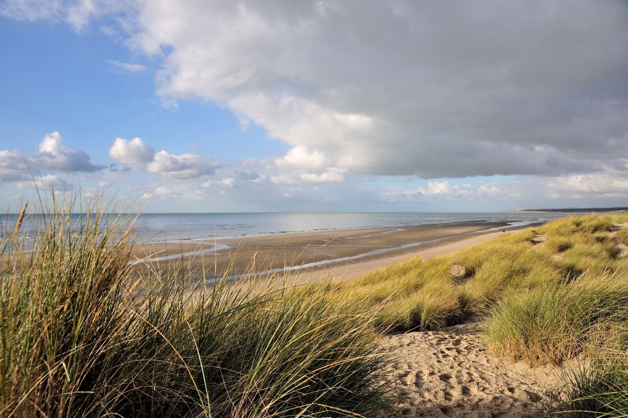
Opal Coast Trip {Year}
Insert additional information here

