Slide 1
Your Battlefields Tour {Year}
{School Name Here}, Years {7 & 8}

Slide 2
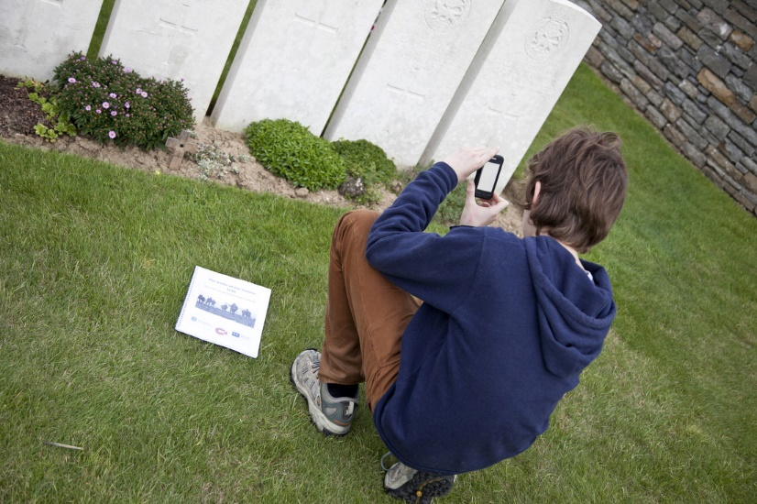
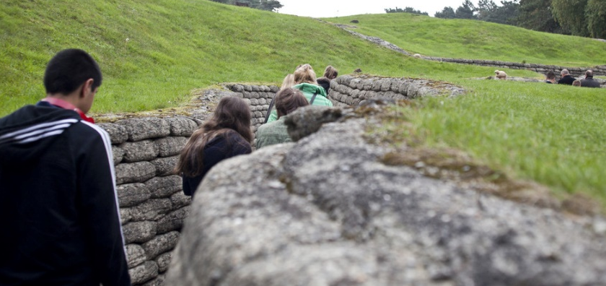
Battlefields Trip {Year}
{school name}
Why book with Equity?
INSPIRING LEARNING EXPERIENCES FOR YOUNG PEOPLE
For us, a tour is more than just travelling to a new place, it’s the inspiring learning experiences you have when you get there. We use over 80 years of experience to deliver a tour that not only meets your needs but adds something that little bit different to make it an experience to be remembered.

Slide 3
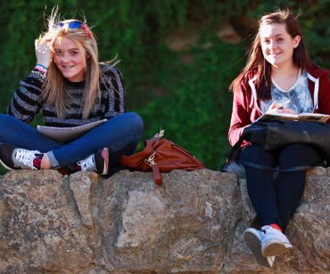
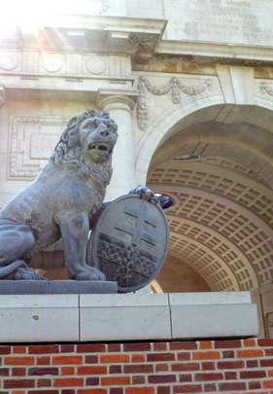
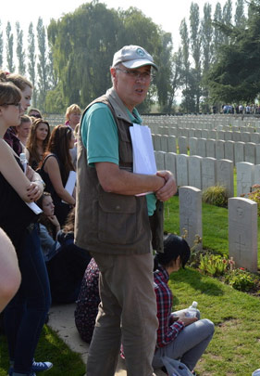
Battlefields Trip {Year}
{school name}
Your Header
YOUR SUBTITLE
Here is some dummy content for your main paragraph of a standard page. Use this layout to provide info on the resort and any other relevant information. Use this layout to provide info on the resort and any other relevant information.

Slide 4
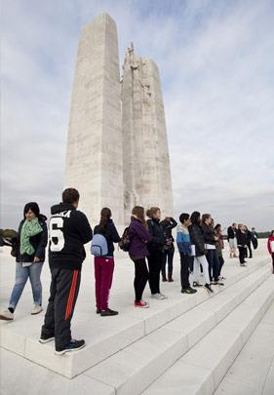
Where will we visit?
Flanders Fields museum
Sanctuary Wood
Menin Gate/Last Post
Tyne Cot Cemetry
Langemark Cemetry
Memorial Museum Passchendaele
Lochnager Crater
Thiepval British Memorial
Somme 1916 Museum
Beaumont-Hamel Memorial Park
Longueval Memorial
Vimy Ridge

Slide 5
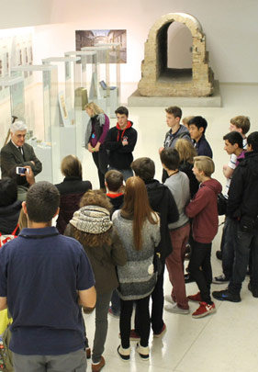
Battlefields Trip {Year}
What are our History objectives?
Acknowledge the importance of key historical events
Witness the sheer scale of trench warfare
Imagine conditions for those who fought in WWI
Study artefacts and sources in their original context
Draw conclusions about events and their consequences

Slide 6
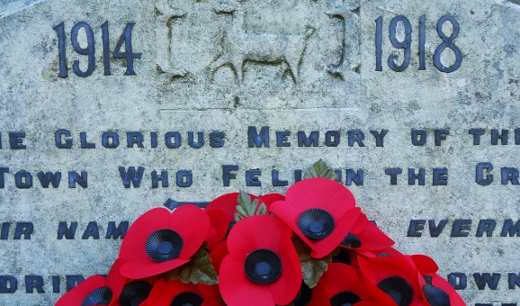
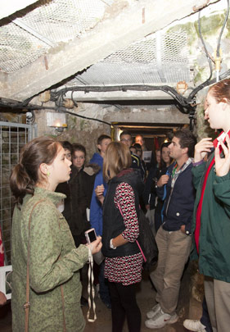
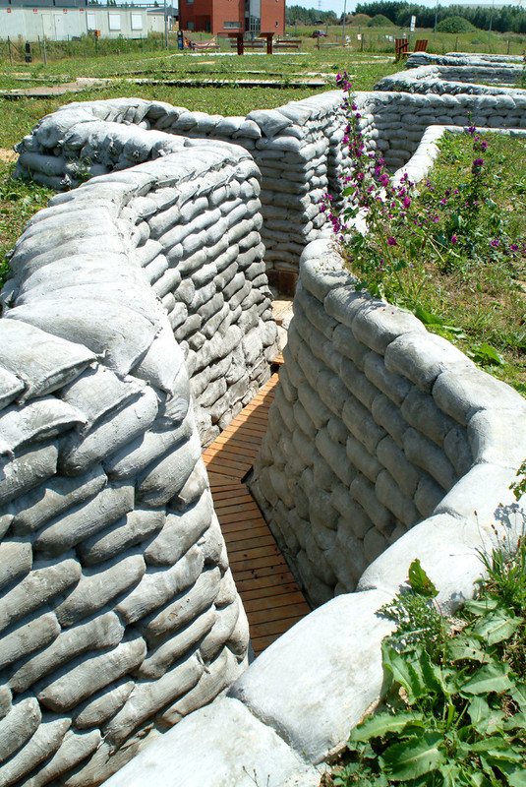
Battlefields Trip {Year}
Insert additional information here

Slide 7
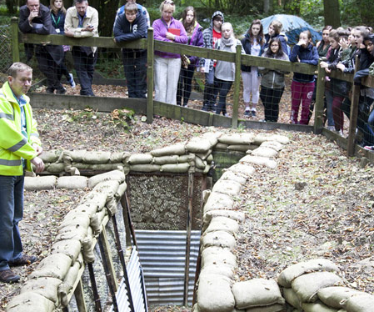
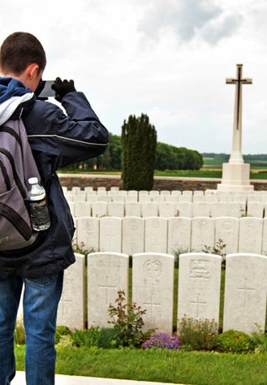
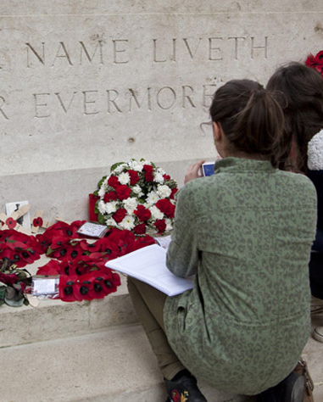
Battlefields Trip {Year}
Insert additional information here

