Slide 1
Your London Tour {Year}
{School Name Here}, Years {7 & 8}

Slide 2
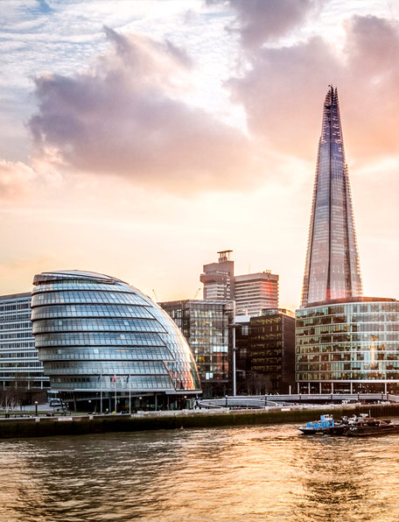
London Trip {Year}
{school name}
Why book with Equity?
INSPIRING LEARNING EXPERIENCES FOR YOUNG PEOPLE
For us, a tour is more than just travelling to a new place, it’s the inspiring learning experiences you have when you get there. We use over 80 years of experience to deliver a tour that not only meets your needs but adds something that little bit different to make it an experience to be remembered.

Slide 3
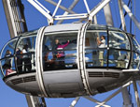

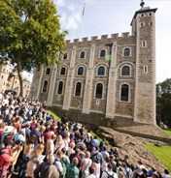
London Trip {Year}
{school name}
Your Header
YOUR SUBTITLE
Here is some dummy content for your main paragraph of a standard page. Use this layout to provide info on the resort and any other relevant information. Use this layout to provide info on the resort and any other relevant information.

Slide 4
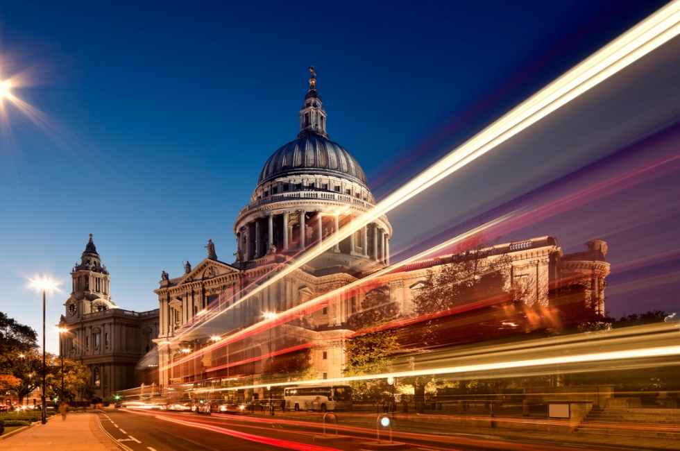
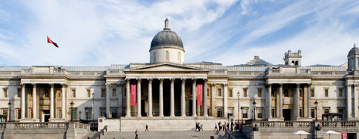
Where will we visit?
West End Theatre Trip
London Olympic Tour
Imperial War Museum
Natural History Museum
Science Museum
Thames River Cruise
Tate Modern and Britain
Victoria and Albert Museum
National Gallery
National Portrait Gallery
Saatchi Gallery
Cabinet War Rooms
Florence Nightingale Museum
Cutty Sark
British Music Experience
Thames Barrier Tour

Slide 5
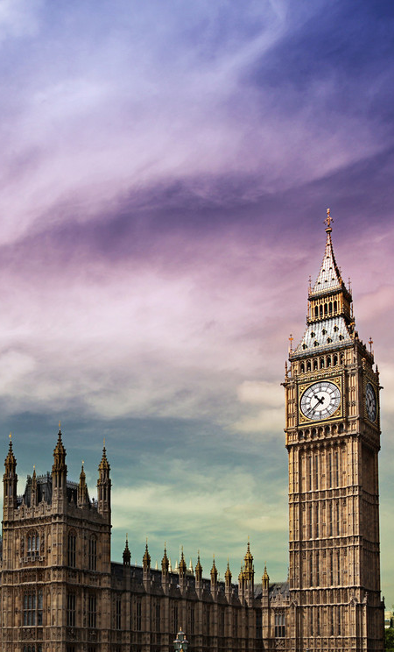
London Trip {Year}
What are our Politics objectives?
Visit the places where major political decisions have been made
Watch politics in action in a parliamentary debate
Learn how the judiciary operates at the new Supreme Court
Visit the impressive Thames location of City Hall
Take a tour of the Supreme Court

Slide 6
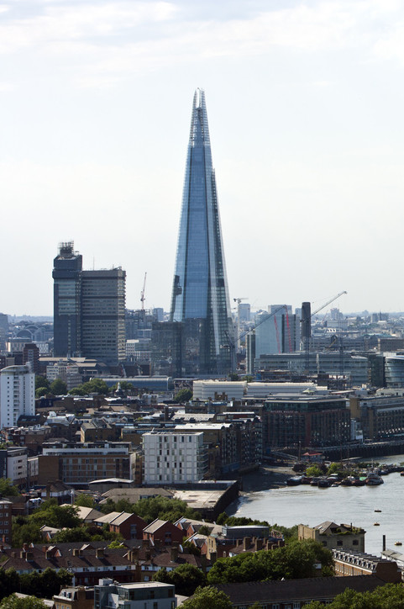
London Trip {Year}
What are our Business Studies objectives?
Identify why London is so important to
global economies
Investigate Coca-Cola’s marketing techniques
Gain insight into the workings of the Bank of England
Take a behind-the-scenes tour of Wembley Stadium
Assess the business practices of an
independent brewery
Contrast activities in the Square Mile with Canary Wharf

Slide 7
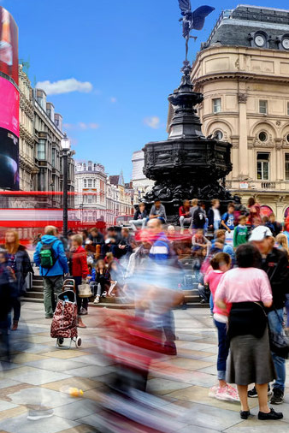
London Trip {Year}
What are our Geography objectives?
Identify characteristics of a world city
Investigate flagship urban development
Consider negative and positive effects of rebranding
Assess risks of urban hazards such as pollution and flooding
Weigh up the success of the Olympic developments
Identify sustainable transport initiatives

Slide 8
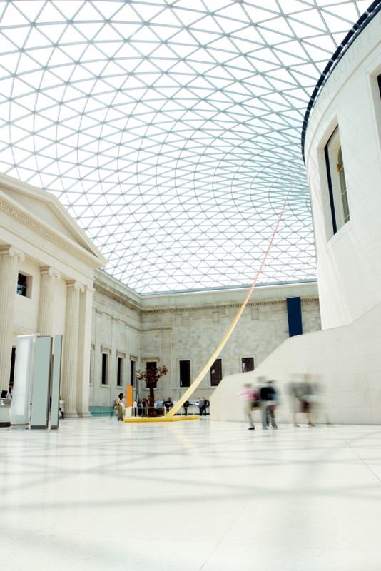
London Trip {Year}
What are our Art & Design objectives?
Investigate the masterstrokes of famous artists
Track development of Art movements and their influences
See how major twentieth century ideas link to the past and now
Experience modern architecture in an urban context
Investigate photography, ceramics or textiles
Identify street art and urban street design

Slide 9
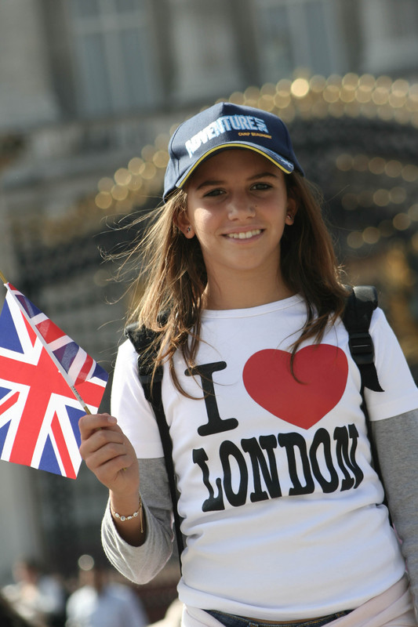
London Trip {Year}
What are our English objectives?
Explore how texts relate to their historical contexts
Engage with the world of literature beyond the classroom
Appreciate the heritage of the English language
Evaluate and respond constructively to performances
Gain inspiration and motivation for creative writing
Discover a renewed passion for English literature

Slide 10
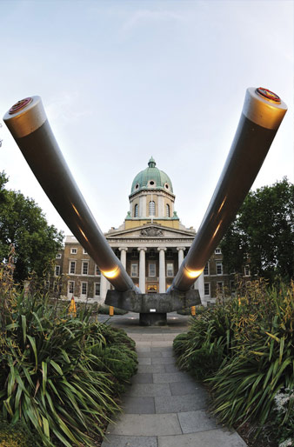
London Trip {Year}
What are our History objectives?
Delve into the 1000 year history of London’s oldest fortress
Appreciate the pioneering medical work of Florence Nightingale
See where Churchill’s government planned the defeat of Nazi Germany
Explore the vast scope of the Imperial War Museum
Trace the history of this majestic city at the Museum of London
Understand how science and technology have transformed everyday lives

Slide 11
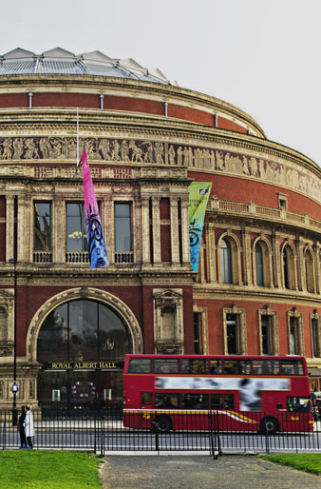
London Trip {Year}
What are our Music objectives?
Increase self-confidence and develop performance skills
Broaden range of performance experiences
Build appreciation of different musical styles and traditions
Inspire and excite your students with new sights and cultures
Focus your pupils to extend their interest in music
Build team work and have fun interacting with fellow students

Slide 12
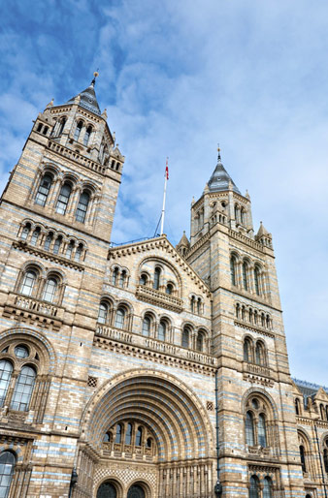
London Trip {Year}
What are our Maths objectives?
Use practical experience as a basis for maths discovery
Trace the developments of maths worldwide
Appreciate the relevance of historic discoveries in modern maths
Reinforce learning through experimentation, observation and analysis
Explore creative and commercial applications of maths
Recognise the importance of ethics and sustainability
Discover new and exciting career opportunities within maths

Slide 13
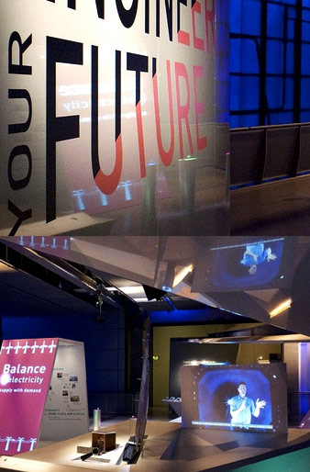
London Trip {Year}
What are our Science objectives?
Use practical experience as a basis for scientific discovery
Trace the developments of science worldwide
Appreciate the relevance of historic discoveries in modern science
Reinforce learning through experimentation, observation and analysis
Explore creative and commercial applications of science
Recognise the importance of ethics and sustainability
Discover new and exciting career opportunities within science

Slide 14
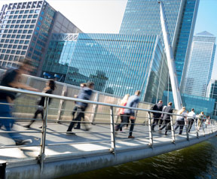
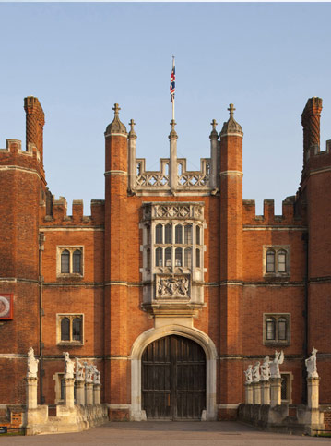
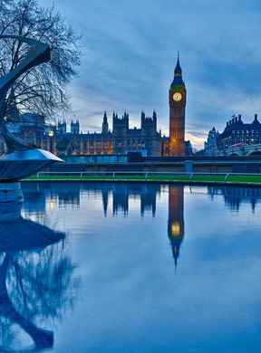
London Trip {Year}
Insert additional information here

Slide 15
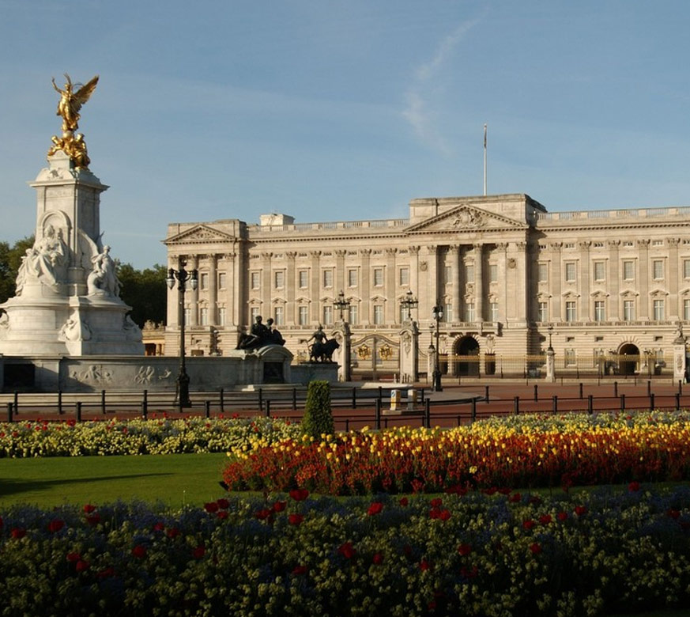
London Trip {Year}
Insert additional information here

