Slide 1
Barcelona Trip {Year}
{School Name Here}, Years {7 & 8}

Slide 2
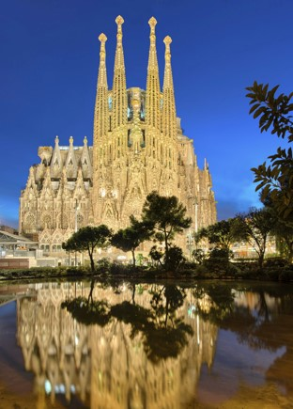
Barcelona Trip {Year}
{school name}
Why book with Equity?
INSPIRING LEARNING EXPERIENCES FOR YOUNG PEOPLE
For us, a tour is more than just travelling to a new place, it’s the inspiring learning experiences you have when you get there. We use over 80 years of experience to deliver a tour that not only meets your needs but adds something that little bit different to make it an experience to be remembered.

Slide 3
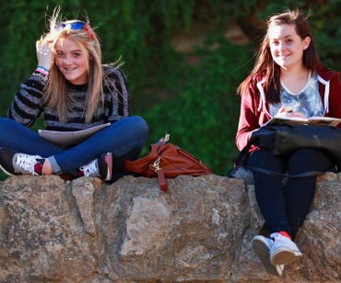
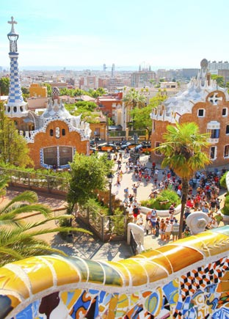
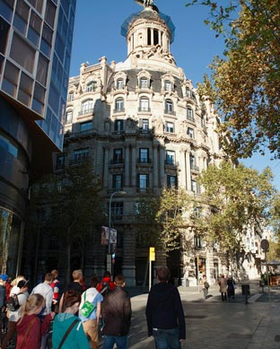
Barcelona Trip {Year}
{school name}
Your Header
YOUR SUBTITLE
Here is some dummy content for your main paragraph of a standard page. Use this layout to provide info on the resort and any other relevant information. Use this layout to provide info on the resort and any other relevant information.

Slide 4
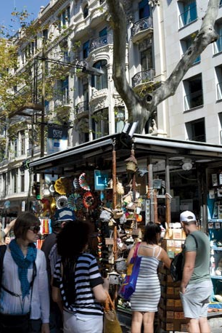
La Sagrada Familia
Picasso Museum
Museum of Catalonian Art
Dali Museum
Joan Miro Foundation
Parc Guell
Cosmo Caixa Science Museum
Port Vell Old Harbour
Las Ramblas
Camp Nou Stadium
Poble Espanyol
Gaudi Centre
Cardona Salt Mountain
Montserrat National park
PortAventura

Slide 5
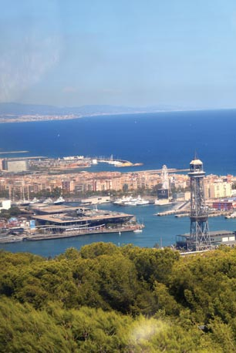
Barcelona Trip {Year}
What are our Geography objectives?
Consider to what extent the city has been rebranded
Observe evidence of sustainable initiatives
Identify the challenges of Catalan separatism
Evaluate development and success of the Olympic site
Contrast coastal processes and management techniques
Investigate impacts of urban and coastal tourism

Slide 6
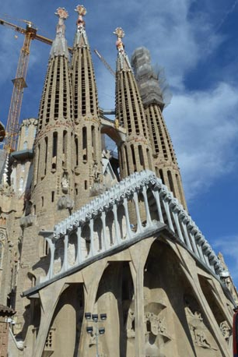
Barcelona Trip {Year}
What are our Maths objectives?
Identify links between Maths and Art.
Examine architectural shape and functionality.
Get mathematical on Europe’s tallest rollercoaster.
Investigate visitor numbers and capacity.
Use trigonometry to calculate height of structures.
Consider how designers use materials to create shape

Slide 7
Barcelona Trip {Year}
What are our Languages objectives?
Practise listening and speaking skills in everyday scenarios
Learn to communicate with increasing confidence
Build on existing linguistic understanding and develop a wider range of vocabulary
Apply linguistic knowledge and skills in new and challenging settings
Gain first-hand experience of Spanish culture and society

Slide 8
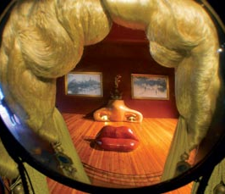
Barcelona Trip {Year}
What are our Art & Design objectives?
Investigate Dali's surrealism and the principles of this movement
Critically review the curation and layout of art galleries
Analyse Miro's work visualising his progression to symbolism and abstraction
Discover the works of Gaudi assessing his contribution to Art Nouveau
Compare public space design principles of the Olympic Park and Park Guell
Record how the natural world has influenced twentieth century artists

Slide 9
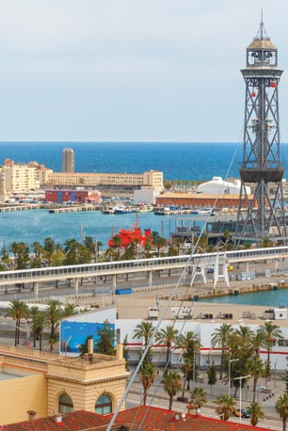
Barcelona Trip {Year}
What are our Business Studies objectives?
Identify factors that made Barcelona a major trading port
Investigate the workings of the fashion trade
Assess the specific problems of running major sporting facilities
Observe automated production facilities
Examine production line processes from start to finish
Contrast traditional and contemporary organisations

Slide 10
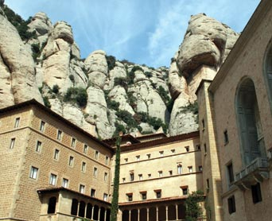
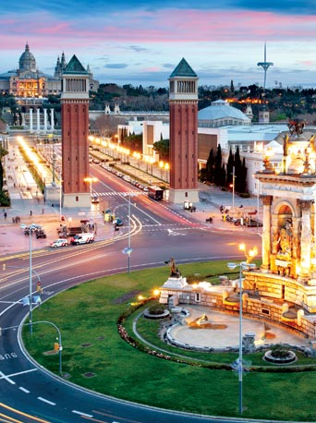
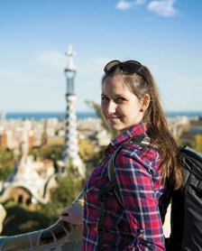
Barcelona Trip {Year}
Insert additional information here

Slide 11
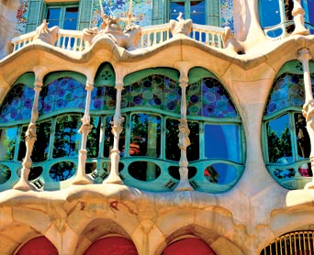
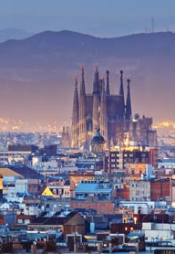
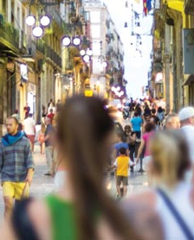
Barcelona Trip {Year}
Insert additional information here

