Slide 1
Your Paris Tour {Year}
{School Name Here}, Years {7 & 8}

Slide 2
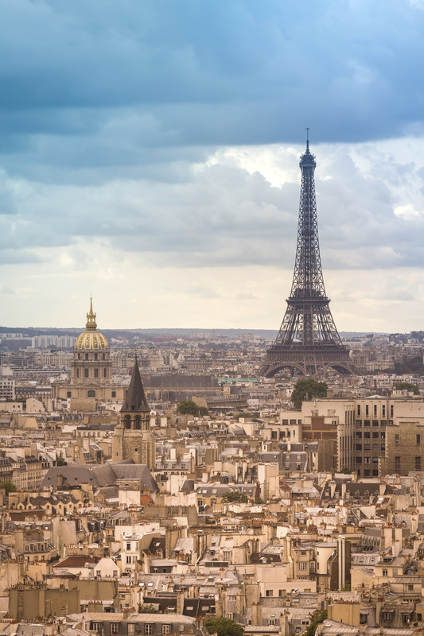
Paris Trip {Year}
{school name}
Why book with Equity?
INSPIRING LEARNING EXPERIENCES FOR YOUNG PEOPLE
For us, a tour is more than just travelling to a new place, it’s the inspiring learning experiences you have when you get there. We use over 80 years of experience to deliver a tour that not only meets your needs but adds something that little bit different to make it an experience to be remembered.

Slide 3
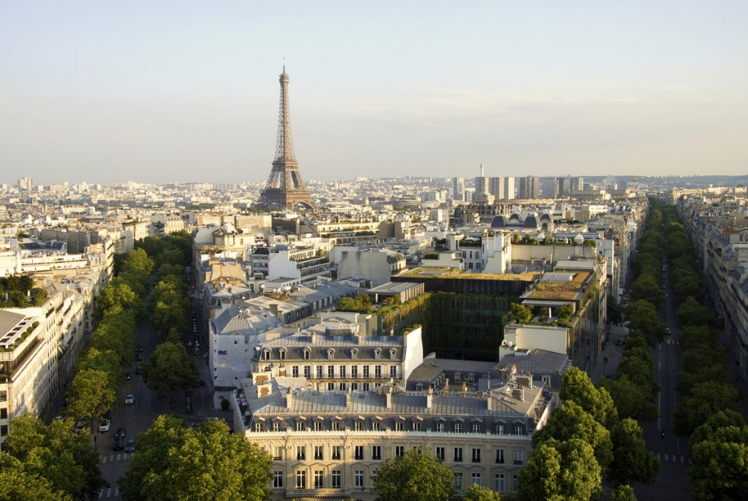
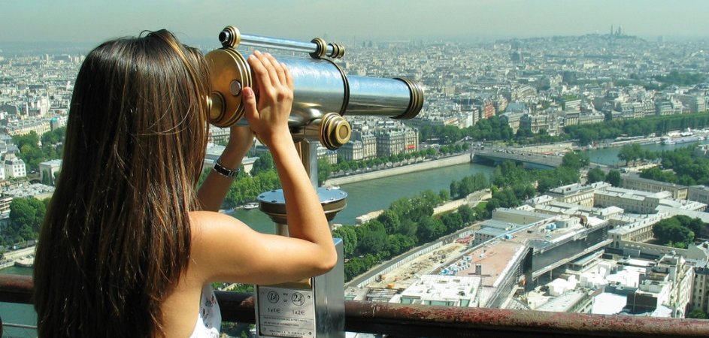
Paris Trip {Year}
{school name}
Your Header
YOUR SUBTITLE
Here is some dummy content for your main paragraph of a standard page. Use this layout to provide info on the resort and any other relevant information. Use this layout to provide info on the resort and any other relevant information.

Slide 4
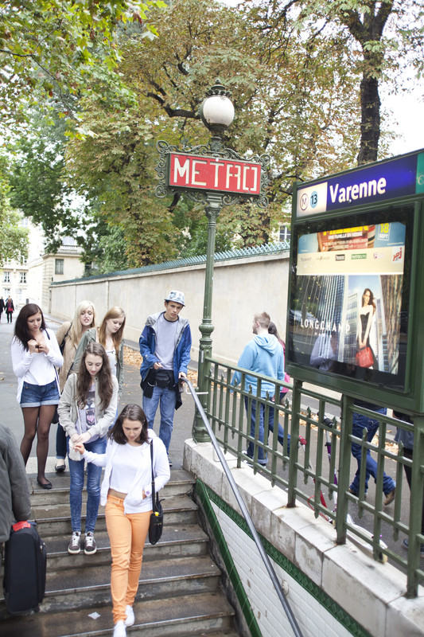
Where will we visit?
Cite de Sciences
Tour Montparnasse
La Conciergerie
Les Invalides
Bateaux Parisiens
Eiffel Tower
Stade de France
Le Louvre
Pompidou Centre
Versailles Palace
Musée D'Orsay
Maison Europeene de
Photographie
Musée des Artes Decoratif
Musée Rodin
Musée d'Artes Moderne
Pere Lachaise Cemetery
Musée de la Resistance
Parc Asterix
DisneyLand

Slide 5
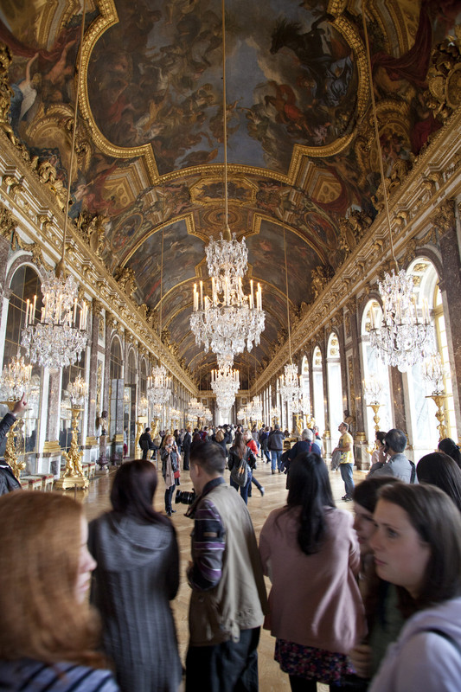
What are our Art & Design objectives?
Paris Trip {Year}
Enjoy one of the most influential artistic centres of the world
Promote understanding of how art relates to place, context and culture
Identify how Picasso’s style changed from representation to abstraction
Photograph modernist architecture, analyse effects on the Parisian atmosphere
Investigate how Impressionists painted everyday local society
Enhance cross-curricular understanding
Have fun discovering the creative world with your students

Slide 6
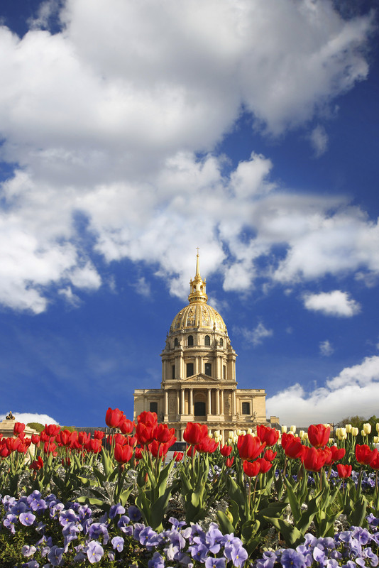
What are our History objectives?
Paris Trip {Year}
Explore the past at the city’s museums and landmarks
Tread in the footsteps of French Revolutionaries
Witness the Eiffel Tower, great technological feat and emblem of the city
Be inspired by stories of heroism and resistance
Promote understanding of continuity and change
Enhance cross-curricular understanding
Have fun discovering darkest Parisian history

Slide 7
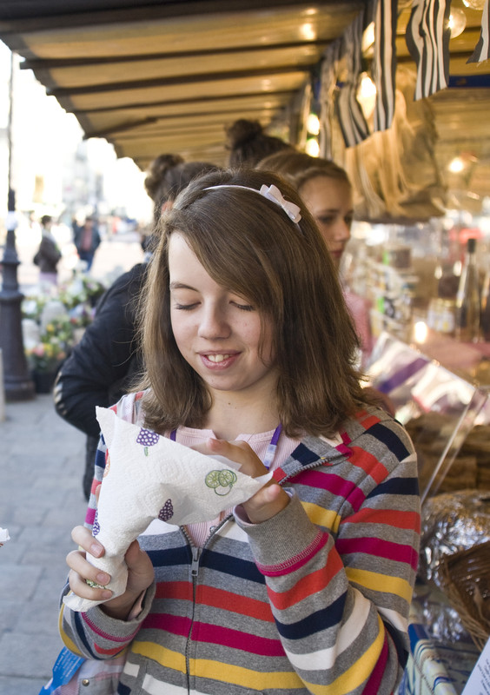
What are our Language objectives?
Paris Trip {Year}
Practise listening and speaking skills in everyday situations
Gain first-hand experience of French culture and society
Build on existing linguistic understanding
Develop a wider range of vocabulary
Apply linguistic knowledge and skills in new challenging settings
Learn to communicate with increasing confidence
Read signs, shop in the market and have fun in French!

Slide 8
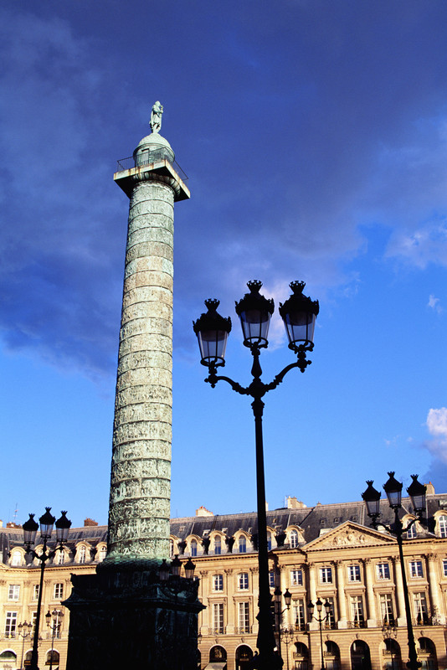
What are our Maths objectives?
Paris Trip {Year}
Investigate chaos theory
Estimate measurements
Identify construction of 3D shapes
Question the accuracy of a 4D cube
Explore the properties of ruled surfaces
Calculate audience numbers, percentages, fractions and decimals

Slide 9
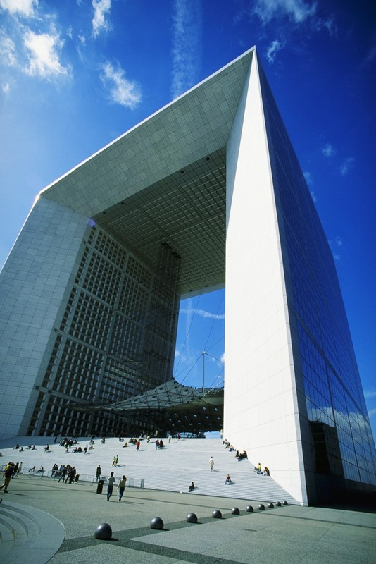
What are our Business Studies objectives?
Paris Trip {Year}
Investigate commercial activities at Disneyland
Evaluate quality of French customer service
Identify French marketing strategies
Take a walking tour of Paris’s financial district
Visit the latest business exhibition
Consider locational factors of Paris as a business hub

Slide 10
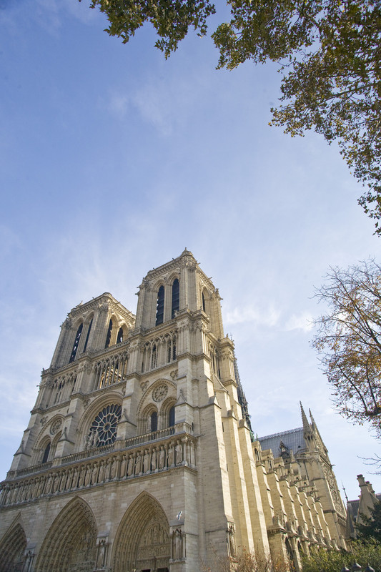
What are our Music objectives?
Paris Trip {Year}
Increase self-confidence and develop performance skills
Broaden range of performance experiences
Build appreciation of different musical styles and traditions
Inspire and excite your students with new sights and cultures
Focus your pupils to extend their interest in music
Build team work and have fun interacting with fellow students

Slide 11
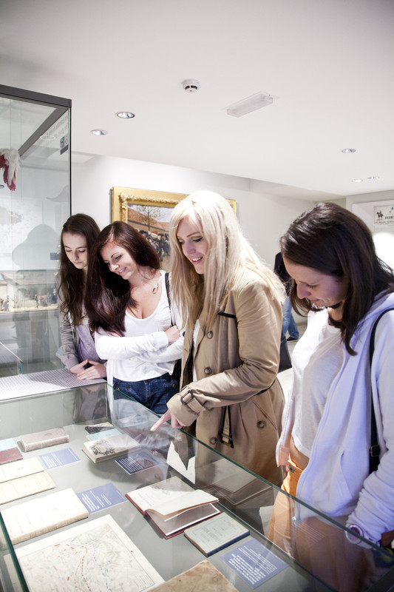
What are our Science objectives?
Paris Trip {Year}
Appreciate the relevance of historic discoveries in modern science
Reinforce learning through experimentation, observation and analysis
Explore creative and commercial applications of science
Recognise the importance of ethics and sustainability
Discover new and exciting career opportunities within science

Slide 12
Paris Trip {Year}
Insert additional information here

Slide 13
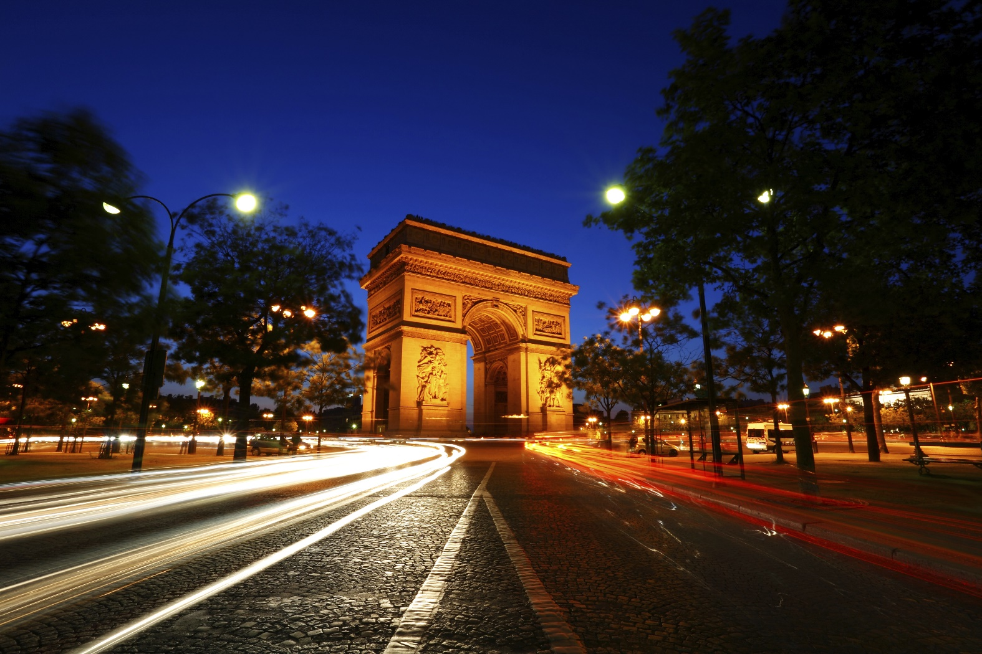
Paris Trip {Year}
Insert additional information here

